Slide 1
Grow Revenue, Community Partnerships and Staff Morale
Notes:
Welcome- This Webinar was created in partnership with the BPAA Diversity and Inclusion committee and Bowling University as part of our continuing webinar series. We are happy to present to you Growing Revenue, Community Partnerships and Staff Morale. (The value of Community Bonding).

Slide 2
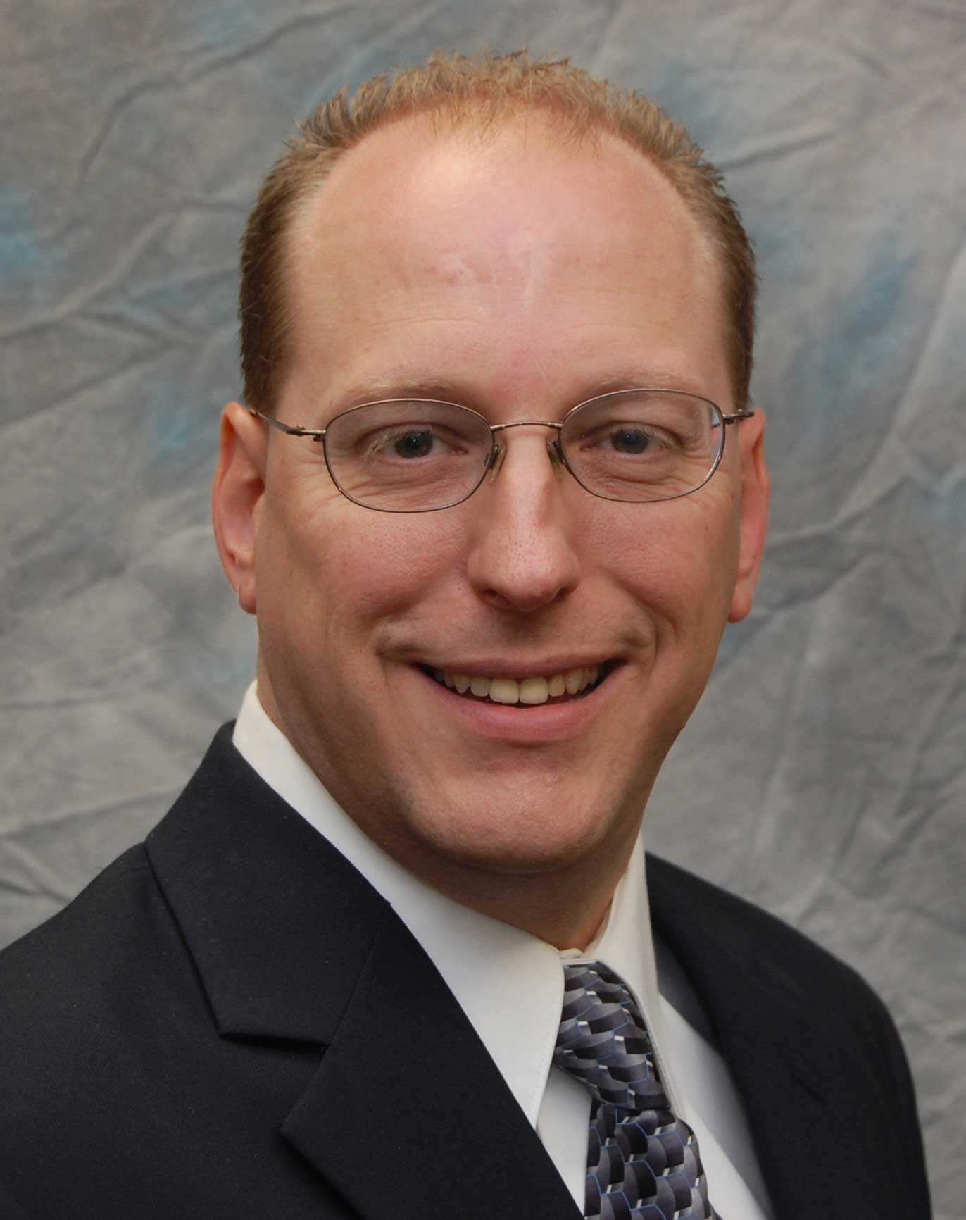
Kelly Bednar
BPAA - Director Education
Notes:
I am Kelly Bednar-- BPAA Director of Education and I will be your host today.

Slide 3
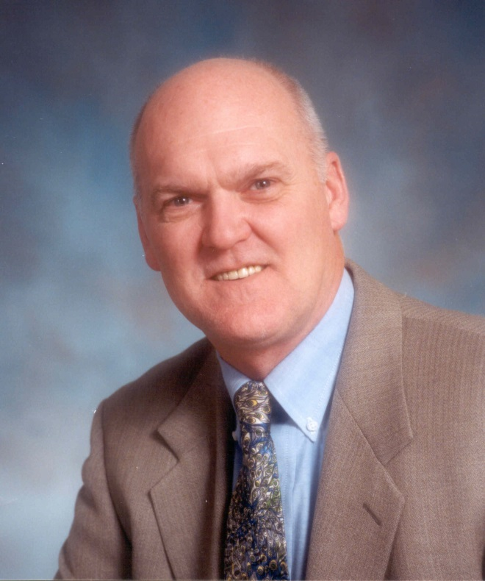
Joe Schumacker
BPAA – Past President
CEO/President – SpareZ Inc.
Notes:
Our facilitator today is an industry veteran and one of the most knowledgeable people on this topic. He is none other than Past BPAA President and current CEO and President of SpareZ Inc. Joe Schmaker
Before I turn this over to Joe and let him describe what the video you just saw was all about, I have just one simple house keeping note for those that are new to the webinar experience.
If you have a question at any time during the presentation please feel free to type it in the question box on your screen. If it is not being covered in the presentation, I will answer if possible in real time or I may use it as a question for the entire group at the end of the presentation. Just know we reserve the right to share questions with the group.
And Second, if time allows and there is enough interest, we will have a verbal question and answer session at the conclusion of the presentation where we will address some of the typed questions and open your mike for audible questions.
To be acknowledged simply “Raise your hand” by clicking the little hand on the control panel on your screen. Let‘s try it. Everyone “raise your hand” and we’ll get started.
Great, at least some of you are still awake. Let’s get started! Welcome Joe! They’re all yours.

Slide 4
Agenda
Concept of Community Bonding
Working with your Community to grow revenue
Getting past the “Cause” to Focus on the Value
It can be as simple as selling pair of socks
Implementing a strategy

Slide 5
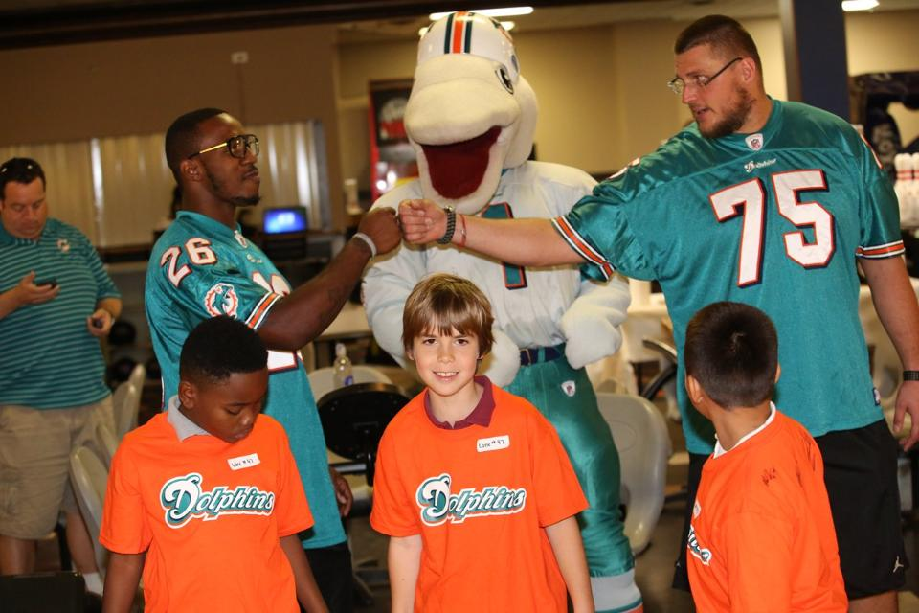
Concept of Community Bonding
The performance of a Core Bowling business is leveraged by the degree it is bonded to the communities it serves.
Notes:
(Start Poll #1)
To what level to you feel that you are a partner with your community?
Kelly-Final reminder to submit response
(End Close Poll)
(Launch results of Poll#1)
(Advance to next slide “Developing a league Bowler”)
(Close Poll #1 Results)

Slide 6
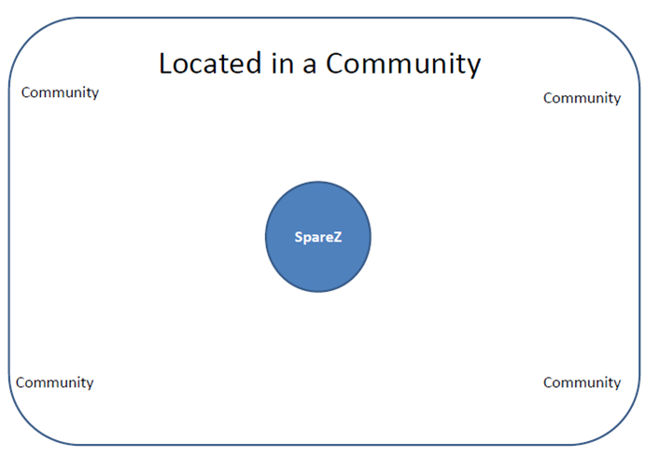
Concept of Community Bonding
My Bowling Business is:
Located in the Community
A Part of the Community

Slide 7
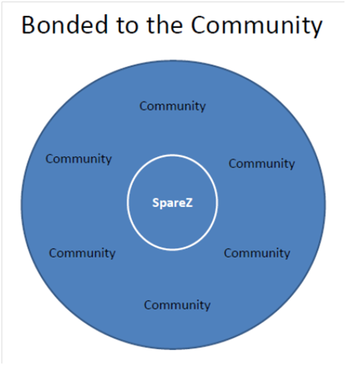
Concept of Community Bonding
My Bowling Business is:
Located in the Community
A Part of the Community
Bonded to the Community

Slide 8
Concept of Community Bonding
Different is not necessarily New!
Improving on a valuable skill from the past can be more valuable than attempting to create something new.

Slide 9
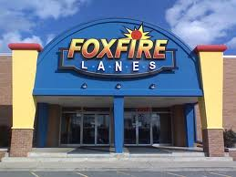
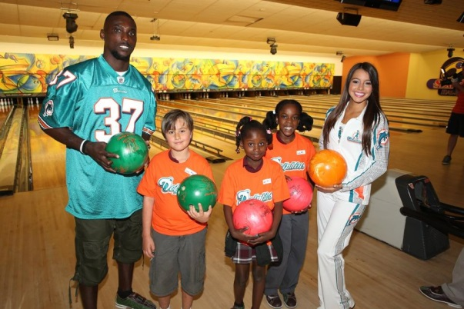
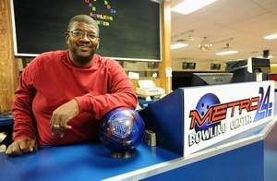
Concept of Community Bonding
3 wins of Community Bonding
The Business Wins
The Community Wins
The Staff Wins

Slide 10
Concept of Community Bonding
Engagement is the Key
In order for Community Bonding to deliver its full potential the entire staff must be engaged.
Value is created through engagement.

Slide 11
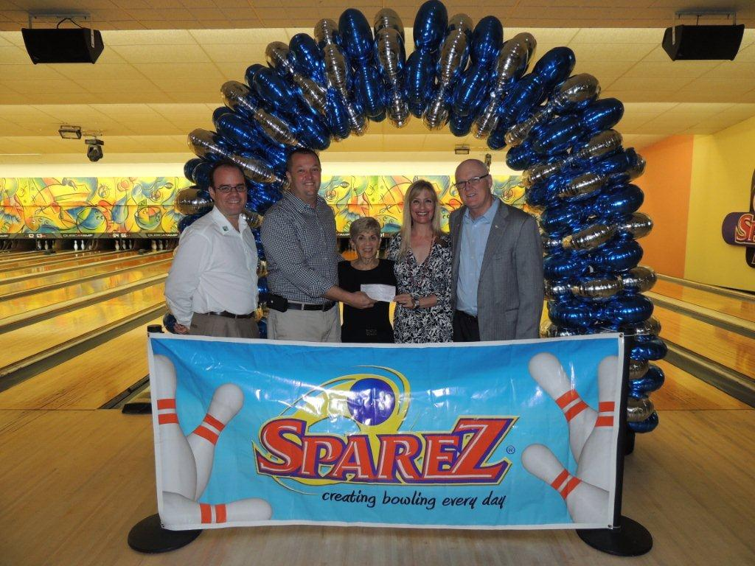
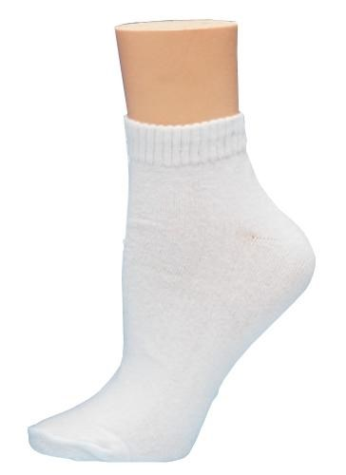
Implementation
Engagement is the Key
For the Community

Slide 12
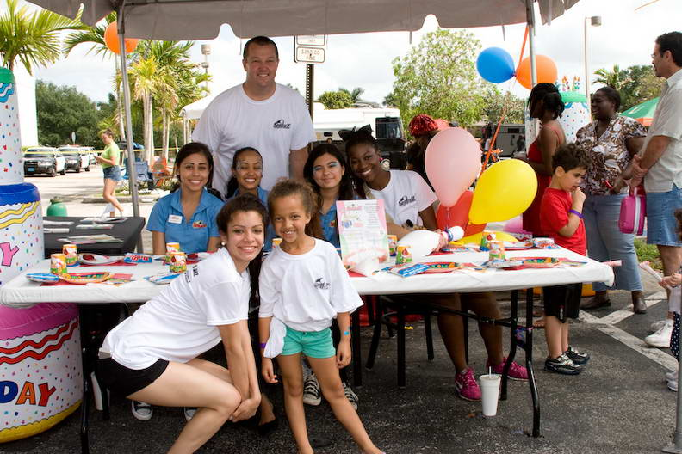
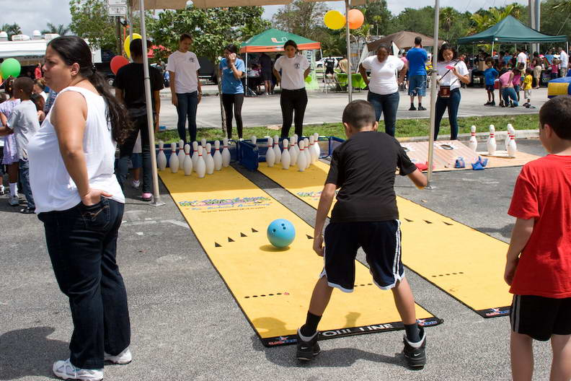
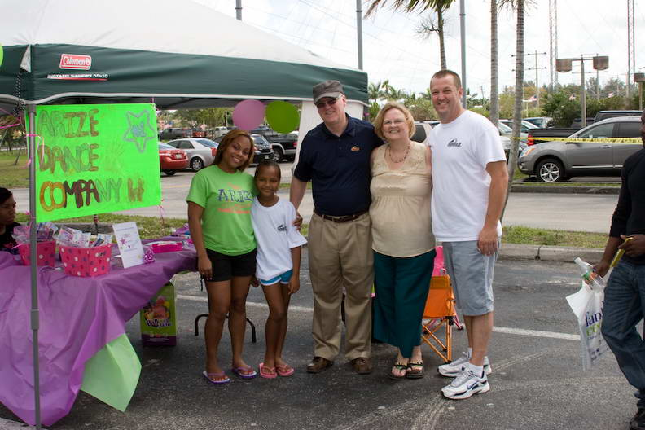
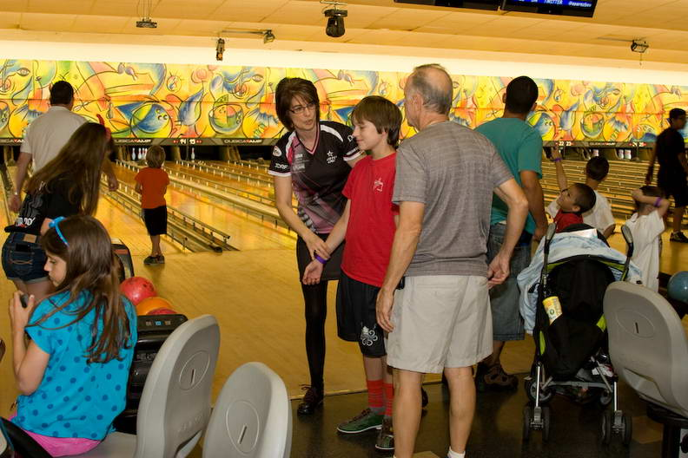
Implementation
Engagement is the Key
For the Community

Slide 13
Implementation
Engagement
is the Key
For the Staff
Notes:
(Start Poll #2)
Now that you have seen this presentation, to what extent would you like to learn more about creating a bond with your community?
Kelly-Final reminder to submit response.
(End Close Poll)
(Launch results of Poll#2)
(Advance to next slide “Developing a league Bowler”)
(Close Poll #2 Results)

Slide 14
Questions
Notes:
Reminder- To ask a question you can type in your question and we’ll read it for you
or simply click the “Raise my hand” button on your control panel and we will unmute your phone and acknowledge you.

Slide 15
Questions
For more information and links to examples of Community Bonding in action go to
www.joeschumacker.com

Slide 16
Thank You!!!

